Slide 1

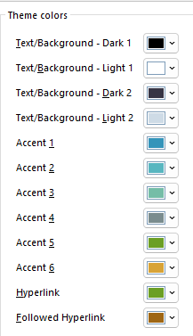
MSV Logo & Font Scheme
Font : Montserrat
Colour Scheme: Custom MSV Option 1
Logo Only
Title + Slogan
Logo + Title + Slogan

Slide 2
Original
Mining Services Vietnam
UNCOVERING POTENTIAL, DRIVING PROGRESS

Slide 3

Logo Only
Shape Format
Picture White Background
Format

Slide 4

Mining
Services
Vietnam
UNCOVERING POTENTIAL
DRIVING PROGRESS

Slide 5
Original
Mining
Services
Vietnam
Mining Services Vietnam
UNCOVERING POTENTIAL, DRIVING PROGRESS
UNCOVERING POTENTIAL
DRIVING PROGRESS

Slide 6
Watermark

